Slide 1





Flappy Penguin
HCI Final Project
Gernot Brunner - Stefan Cimander - Martin Hartmond - Thomas Weber

Slide 2



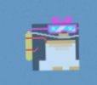
Game Concept
Don’t crash with an Ice Block!

Slide 3
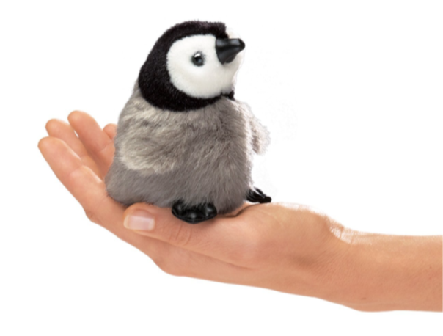
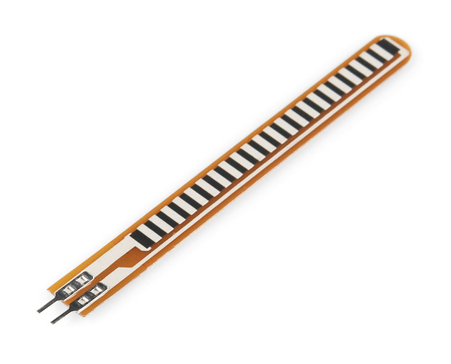
Physical Computing
Integrating Flex Sensor into Penguin Plush Toy

Slide 4
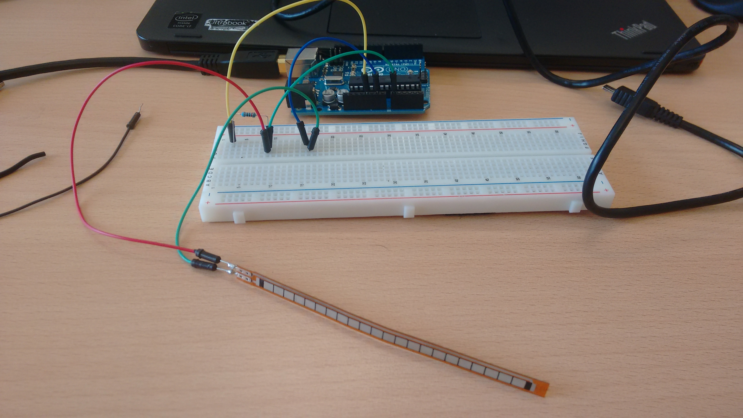
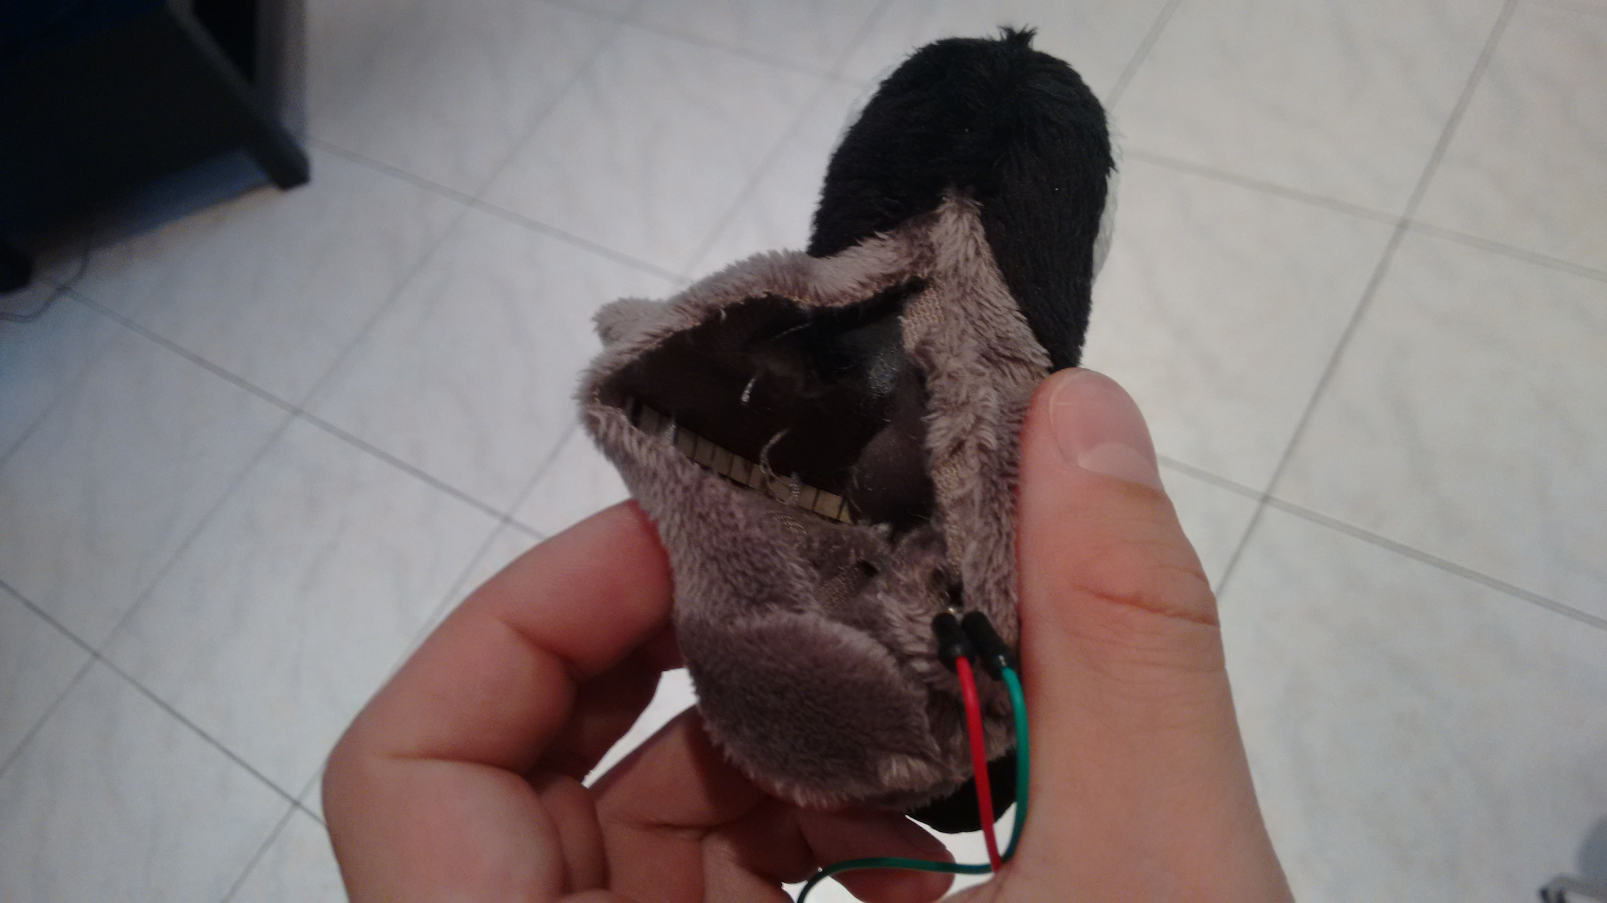
Input Device
Integrating Flex Sensor into Penguin Plush Toy

Slide 5
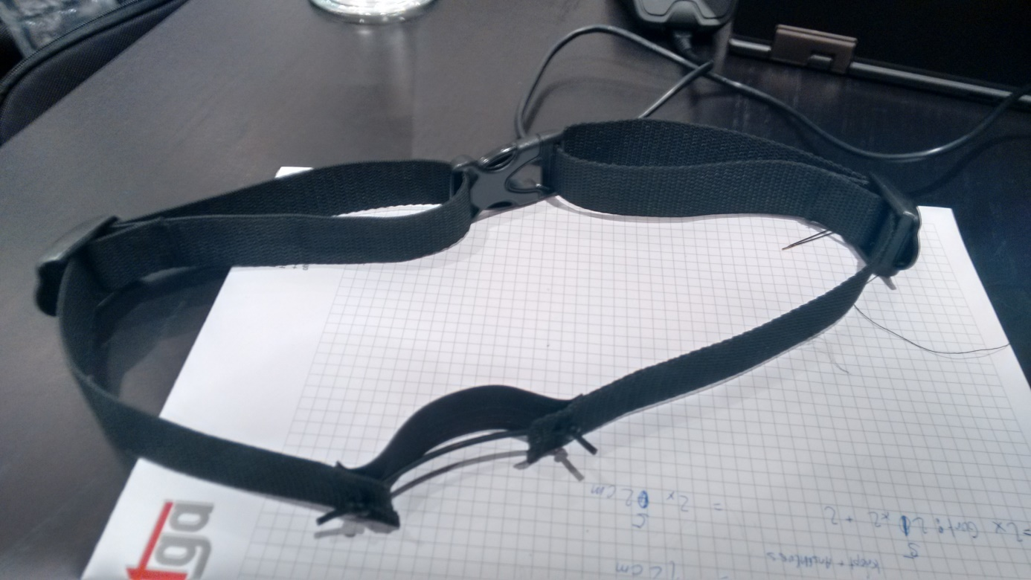
Breathing-Sensor
Using Stretch Sensor for Breath Recognition

Slide 6





Software Stack
Backend
Frontend
Synchronous Rendering Pipeline
Detected User Actions
Asynchronous Callbacks
Sensor Input
Enemy AI
Q-Learning

Slide 7
Reinforcement Learning

Slide 8
Outlook

Slide 9
Demo
Flappy Penguin

